Slide 1


Slide 2
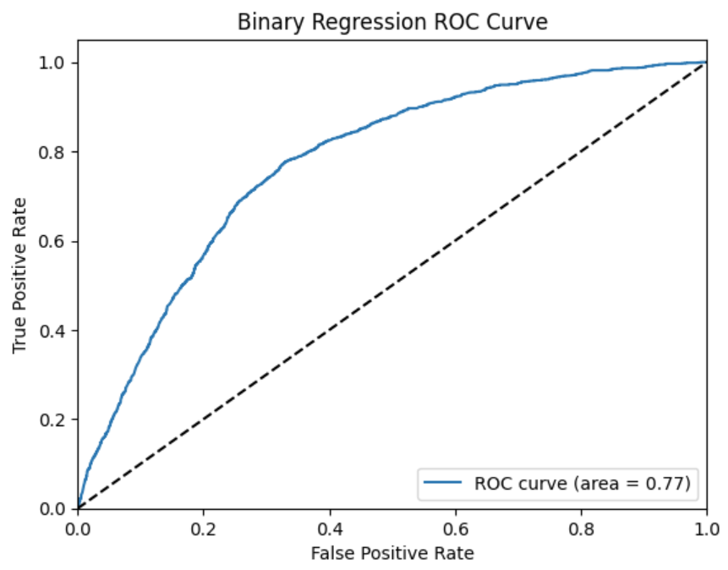
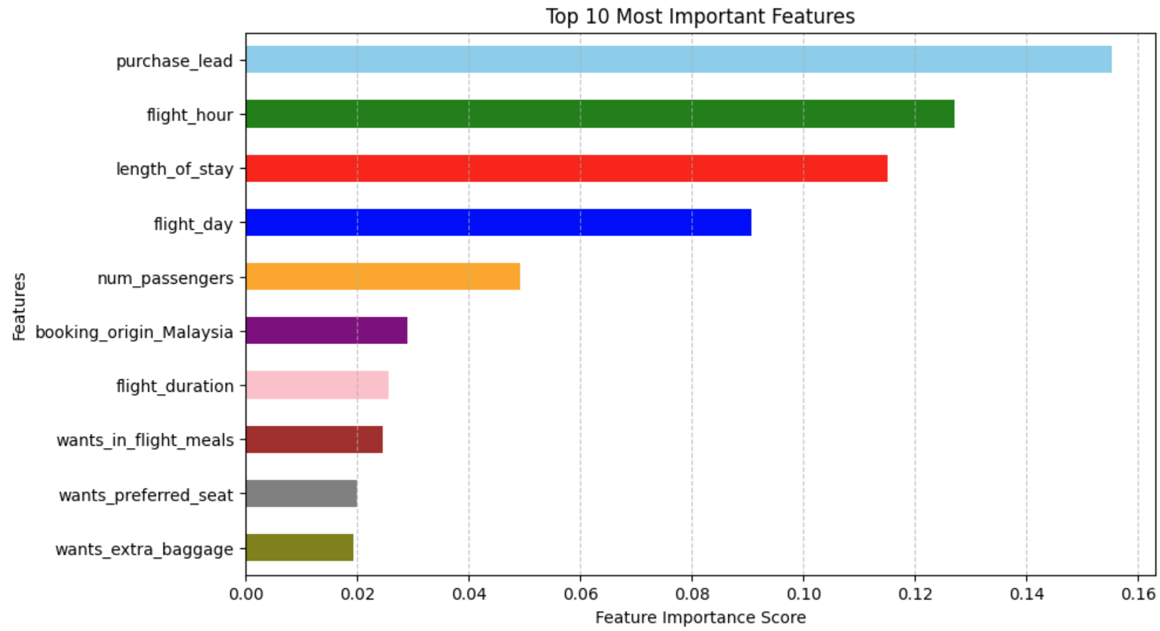
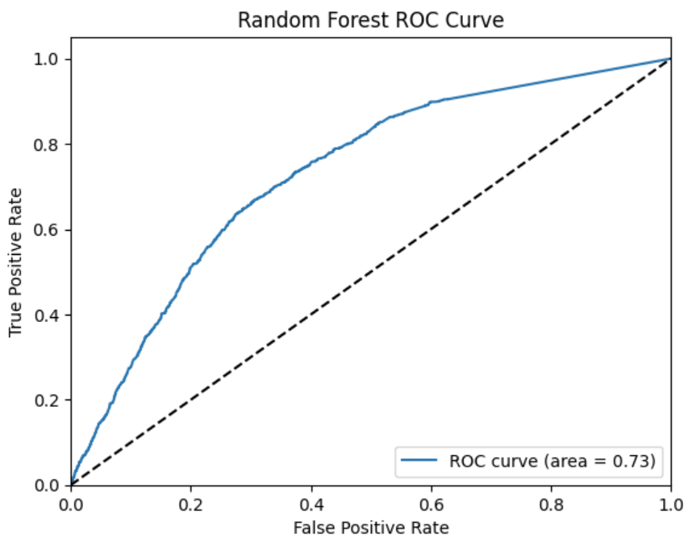
Precision: Correctly identifying a user as a customer/browser
Recall: Correctly identifying all customers
 | Random Forest Classification Model | Binary Regression Model
Accuracy | 85% | 69%
Precision | 48% | 29%
Recall | 12% | 76%

